Slide 1
Workforce Readiness NYS SHRM Leadership Conference
Saturday, April 29, 2017
Notes:
In 2014, SHRM and the SHRM Foundation received a 3-year grant from the Sloan Foundation of more than $900,000 to advance research and develop tools around the Aging Workforce. The goal of these resources is to help organizations understand and solve workforce aging issues that will grow over the next decade. SHRM and the Foundation have spent the past few years creating a series of practical resources that we can now use free-of-charge to prepare our own organizations for these demographic changes. But they won’t make any difference if they aren’t used. So I’m here today to tell you what’s available and encourage you to put these excellent tools to work in your own organization.

Slide 2
Our Purpose and Vision
New Purpose: The SHRM Foundation is a values-based charity organization that champions workforce and workplace transformation and inspires HR professionals to make it happen.
New Vision: Empowered HR professionals building inclusive organizations where all employees thrive and organizations achieve success.
Notes:
The SHRM Foundation is a values-based charity organization that champions workforce and workplace transformation and inspires HR professionals to make it happen. For the last 50 years, the SHRM Foundation has funded two major initiatives: academic research on effective and efficient HR practices, and scholarships for HR professionals and students. Over that 50 year span the SHRM Foundation has impacted the lives of thousands of HR professionals and students by providing research-based HR solutions and scholarships—but it was time for a change—a change of focus.
First, let’s review our new purpose and vision:
New SHRM Foundation Purpose:
The SHRM Foundation is a values-based charity organization that champions workforce and workplace transformation and inspires HR professionals to make it happen.
New SHRM Foundation Vision:
Empowered HR professionals building inclusive organizations where all employees thrive and organizations achieve success.

Slide 3
Our Mission
The SHRM Foundation champions workforce and workplace transformation by providing…
research-based HR solutions for challenging inclusion issues facing employees and potential employees.
scholarships to educate and develop HR professionals and students to make change happen.
opportunities for HR professionals to make a difference in their local communities.
Notes:
Now I am going to tell you about our new mission statement:
New SHRM Foundation Mission:
The SHRM Foundation champions workforce and workplace transformation by providing... research-based HR solutions for challenging inclusion issues facing employees and potential employees.
scholarships to educate and develop HR professionals and students to make change happen.
opportunities for HR professionals to make a difference in their local communities.
Please let me know if you have any questions with the materials shared.

Slide 4
Inclusion Issues Timeline
INCLUSION SOLUTIONS
Notes:
The SHRM Foundation’s focus on inclusion issues will include research-based HR solutions for challenging inclusion issues facing employees and potential employees.
Let’s hear it for the workforce readiness chair and diversity chairs on the call. Our inclusion issues are a great opportunity to collaborate with your fellow volunteer leaders.
Over the next few years, we will be researching and providing resources about integrating veterans into the workforce, workplace gender equality issues and more. This year we are launching our Veterans initiative which will conclude in 2018.

Slide 5
Inclusion Issues and Solutions Resources for Chapters and States
Report summarizing research and best practices
Case studies of organizations hosting strong inclusion programs
Business case for building and sustaining an inclusion program
Presentations to share with your members and local business community
INCLUSION SOLUTIONS
Notes:
For each inclusion issue, the SHRM Foundation will: Report summarizing research and best practices, Case studies of organizations hosting strong inclusion programs, Business case for building and sustaining an inclusion program, Presentations to share with your members and local business community
The first year of the initiative is when we conduct the research and develop our resources. The next year, the chapters and state councils will receive resources they can use for chapter and state council programming.
During the next few slides you will learn how you can earn your chapter/council the Aging Workforce Partner digital badge.

Slide 6
Aging Workforce Initiative
Notes:
Did you know that 10,000 Baby Boomers turn 65 every day?
How about that younger workers are more likely than mature workers to leave an organization taking their new skills with them?
Workers over the age of 50 do not cost significantly more than younger workers.
In 2014 the SHRM Foundation received a grant from the Sloan Foundation to launch a new initiative in partnership with SHRM around the aging workforce. In the past three years, the SHRM Foundation and SHRM have advanced research and published new resources and templates to support older workers and challenge myths about older workers.
We need your help to educate HR professionals and business leaders about the business care for hiring and retaining older workers. To help advance this issue the SHRM Foundation is providing resources and recognition for chapters and councils who engage their members.
The SHRM Foundation is asking chapters and state councils to complete these five steps to engage and educate your members in 2017. When you complete these five steps and submit the survey, you’ll receive a digital badge to display on your website and email newsletter.
Further information is available online at shrmfoundation.org/aginginitiative and in a short flyer that was mailed to chapters and councils last fall, and will be mailed again in the coming weeks.
Many of the steps mentioned are easy to accomplish and align with many of the things your chapter or council are already doing!
The first step is to make a commitment to participate. Second, poll your members to compare your members’ readiness for the aging workforce using a national survey provided by SHRM research. Third, present a 10-minute PowerPoint presentation at a chapter or state council meeting and include the results from your survey.
Fourth, add a link to the SHRM Foundation’s aging workforce resources to your website.
Fifth, engage your member in a project to make a difference for older workers in your community. Ideas for a local service project include:
- Offer resume and interview coaching for mature workers
- Present the short Aging Workforce presentation above to your local Chamber of Commerce or other business group
- Invite a speaker from SHRM's Speaker's Bureau to give a chapter program on "HR and the Aging Workforce: Strategies and Best Practices"
- Contact your local AARP office to partner on local events

Slide 7
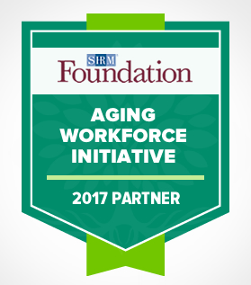
Aging Workforce Initiative
Make this part of your 2017 programming
Register as a partner and earn a badge
Qualify for a Pinnacle or Innovation Award
Learn more: shrmfoundation.org/aginginitiative
Notes:
The Aging Workforce initiative is a great programming idea that will help you share best practices about employing older workers with your members. Also, your service projects are the type of projects that we look for in the Pinnacle Award and Innovation Award entries. Both award submissions are due in the Fall. More information about recognition opportunities will be shared shortly.
The SHRM Foundation has developed a suite of resources and tools to help you engage your members. To download the resources, you can visit: shrmfoundation.org/aginginitiatve

Slide 8
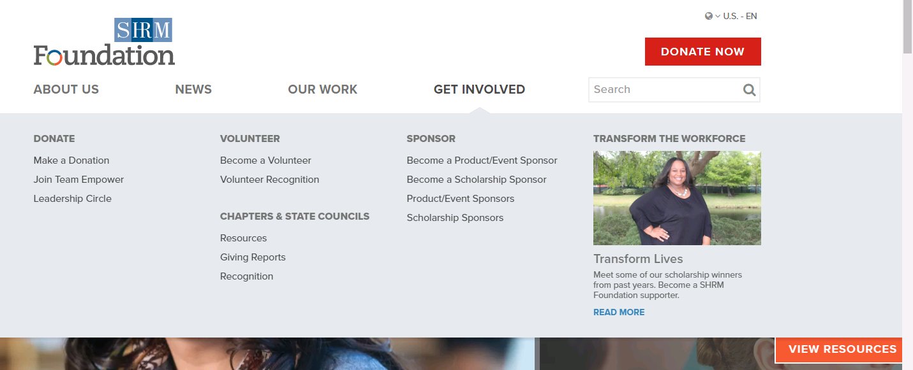
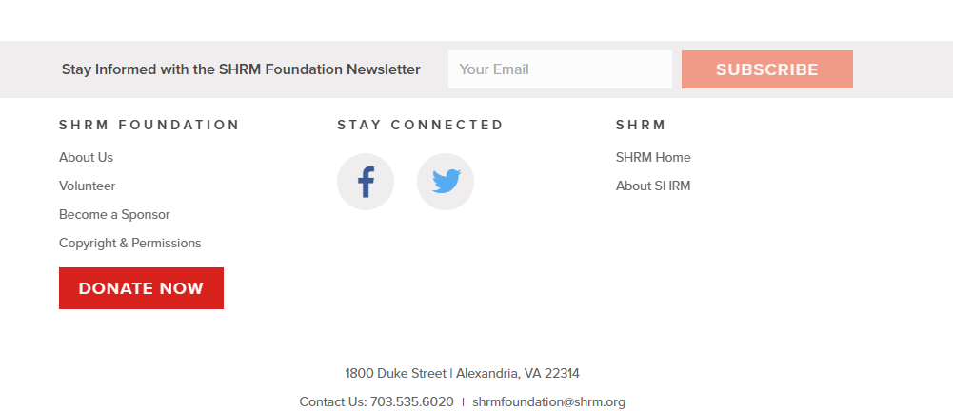
New! SHRM Foundation Website
1
2
Notes:
Along with our new logo and strategy, we have a new even more user-friendly website.
For the certification and workforce readiness/diversity chairs on the call, the Our Work section will be your main area for information on scholarship applications and the aging workforce resources. For the Foundation chairs, head to the Get Involved tab for all your chapter and state council resources. The subtabs include the tool kit, giving reports, and recognition. The giving reports is where you can view how much your chapter/state has fundraised on behalf of the Foundation and a list of members who have donated on behalf of your chapter/state. At the bottom of the slide, you will see where you can sign up for the newsletter. This is on the bottom of every page of our website. Sign up today if you are not already receiving our Monthly Update.

Slide 9
Scholarships
The SHRM Foundation has increased the amount of scholarships available by 27% in 2017.
300+ scholarships totaling almost $500,000!
New scholarships available
Give50 academic scholarship
Diversity and Inclusion Conference Scholarships
SHRM Seminars (in person and virtual) Scholarships
You are the SHRM Scholarship Liaison for your chapter/state!
SCHOLARSHIPS
Notes:
How many scholarship recipients do we have on the webcast today? Let’s hear it for our certification chairs on the call and another cheer for any college relations chairs who are joining us.
Based on your feedback, we have continued to increase the amount of scholarships available as they are one of our key resources for the members. Our scholarships educate and develop HR professionals and students to make change happen.
The SHRM Foundation awards scholarships to empower HR professionals and students. In 2016, 228 scholarships and awards were delivered worth more than $295,000. This year, the SHRM Foundation is increasing the amount of scholarships awarded by 27%, with 314 scholarships and awards being delivered worth almost $500,000.
Specifically for Certification, we have added an extra 30 scholarships to be awarded in 2017.
In addition, the SHRM Foundation will award new scholarships for in-person and virtual SHRM seminars and a $10,000 academic scholarship funded by Give50 donors in 2016.
You are our liaison. This is a great opportunity for Certification, College Relations, and Foundation Chairs to collaborate and set a goal for increased certification scholarship winners from your chapter/council.
Make sure your members are aware of upcoming award opportunities. If they have a question, please direct them to our team. We want your chapters and states to receive scholarships!

Slide 10
Creating local impact
Host a local service project:
Welcome potential members
Invite local business and civic leaders
Deliver Programming to your community
10 minute PowerPoint presentation about aging workforce
Speaker from SHRM Speaker’s Bureau
Fundraise for a cause
Walk for All – Walk-a-thon during a conference
Knock Down Exclusion – bowl-a-thon to raise funds
LOCAL IMPACT
Notes:
Volunteer service projects are a great way to engage local members and welcome potential members. Reach out to partner with a local professional or service organizations on the project. Creating local impact is great to organize alongside your Community Service Chair and Workforce Readiness Chair.
Some potential projects include.
Resume and interview coaching
Offer educational instruction
Connect employers with applicants
Mentor local HR professionals
In addition to hosting a service project, discuss options with your board about how you can deliver programming to your community. Consider presenting at the local business bureau or a partner professional organization. Use a SHRM Foundation DVD with the discussion guide as programming for your next chapter meeting. More ideas can be found on the SHRM Foundation tool kit.
The third area is fundraising for a cause. Plan a fundraiser this year that benefits your members and community. Think beyond the silent auction.

Slide 11
Reviewing and Sharing Goals
Certification Directors:
Set a goal for increased certification scholarship winners from your chapter/council
Foundation Directors:
Set chapter/council goals to achieve SHRM Foundation recognition
Diversity/Workforce Readiness Directors:
Earn your chapter/council the Aging Workforce Partner digital badge
Notes:
With our new strategy we look forward to seeing collaboration with all the volunteer leaders. Working on recognition opportunities and encouraging scholarships is something that we can all get behind. Let’s work together to transform the workplace.

Slide 12
The Aging Workforce
Tools & Strategies for Your Organization
Notes:
In 2014, SHRM and the SHRM Foundation received a 3-year grant from the Sloan Foundation of more than $900,000 to advance research and develop tools around the Aging Workforce. The goal of these resources is to help organizations understand and solve workforce aging issues that will grow over the next decade. SHRM and the Foundation have spent the past few years creating a series of practical resources that we can now use free-of-charge to prepare our own organizations for these demographic changes. But they won’t make any difference if they aren’t used. So I’m here today to tell you what’s available and encourage you to put these excellent tools to work in your own organization.

Slide 13
SURVEY!!!!!

Slide 14
The Reality: Why This Matters
35% of U.S. labor force participants will be age 50+ in 2022. (Up from 25% in 2002.)
45% of unemployed people age 55 to 64 report being unemployed long-term, 27+ weeks (vs. 33% of unemployed 25-34 year-olds)
10,000 Baby Boomers turn 65 every day
Some industries hit hard by Boomer retirements/skills gap:
Educational institutions
Government
Health care
Oil and gas
Manufacturing
How will this affect your workplace? Does your organization have a strategy to recruit, retain and engage these workers?
Notes:
So why focus on the aging workforce right now? Well, here is the big picture in the U.S. More than 1/3 of the labor force will be over age 50 by 2022 (just 5 years away!) People are working longer and delaying retirement. Many of us face challenges in filling open positions, so clearly older workers are an important part of the talent pool that we shouldn’t overlook.

Slide 15
Survey Results
SHRM Survey Results
58% have identified future workforce needs
52% have identified potential skills gaps in the next 1-2 years
35% have analyzed the impact of workers aged 55+ leaving their organization in the next 1-2 years.
Notes:
SHRM conducted a national survey of nearly 2,000 HR professionals to ask about their readiness for an aging workforce. It showed that about half of organizations have started the process of analyzing their workforce and their potential skills gaps, but only 35% of respondents have explored what it will mean for their business when older workers begin to retire. As you can see, we all have more work to do to prepare for these changes.
The results for our chapter/state were…. (similar, different, whatever you found in your local survey.)

Slide 16
Dispelling the Myths
Mature workers (age 50+)…
Do not cost significantly more
Fewer organizations base salary on seniority/years of service than in the past
Are more engaged
65% for workers 55+
58% to 60% for younger workers
Are more loyal & less likely to leave after training
Unplanned turnover is often greater among Millenials than Boomers
Notes:
Some companies do not proactively seek older workers due to common misconceptions. For example, thinking they cannot learn new technology, are resistant to change or are too expensive. However research tells a different story. Many of the new SHRM Foundation resources explain in detail the myths vs. realities of employing mature workers.

Slide 17
Top 5 Advantages of Older Workers
77% -- More work experience/knowledge
71% -- More maturity/professionalism
70% -- Stronger work ethic
63% -- Ability to serve as mentors to younger workers
59% -- More reliability
Source: SHRM Preparing for an Aging Workforce Survey
Notes:
Part of the survey asked about the advantages of older workers. Here’s what your HR peers identified. (read list)

Slide 18
Goals of a Mature Worker Strategy
Retain and engage older workers as long as possible
Transfer their knowledge to younger employees
Leverage their skills after they retire
Recruit older talent from outside
Notes:
This is the bottom line: if you want to leverage mature worker talent, you should focus on these areas. Does your company have strategies in place to achieve these goals? If not, then we challenge you to take action.

Slide 19
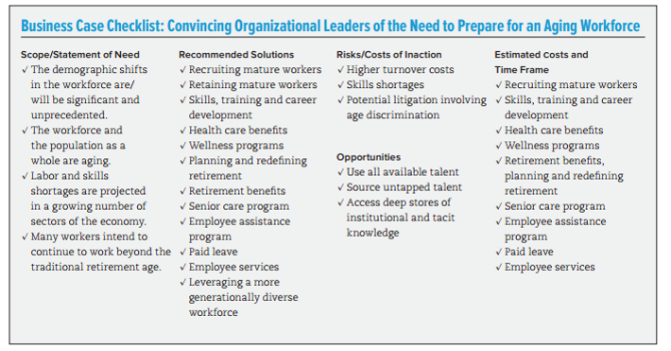
Take Action
Build the business case
Notes:
How do you do that? Here are three easy steps you can follow:
Step one: educate yourself and make the business case to your colleagues and senior management for leveraging older worker talent.

Slide 20
Take Action
2. Assess the state of your aging workforce
Do you need to expand your workforce to meet business demand?
How many workers will be retiring in the next few years?
How will you fill the gaps?
Notes:
Step 2: Assess your current workforce and your future workforce needs. Identify any gaps and start thinking about how to address those.

Slide 21
Take Action
3. Recruit & retain mature workers
Foster an inclusive, age-positive culture
Offer flexible work arrangements
Support health & wellness
Provide caregiver support
Offer targeted skills training
Notes:
Step 3: Review your policies and practices and make changes where needed to support and retain critical older worker talent. You’ll notice that many of the items on this list will also benefit your entire workforce, including offering more workplace flexibility and wellness programs which are very popular with younger workers too.

Slide 22
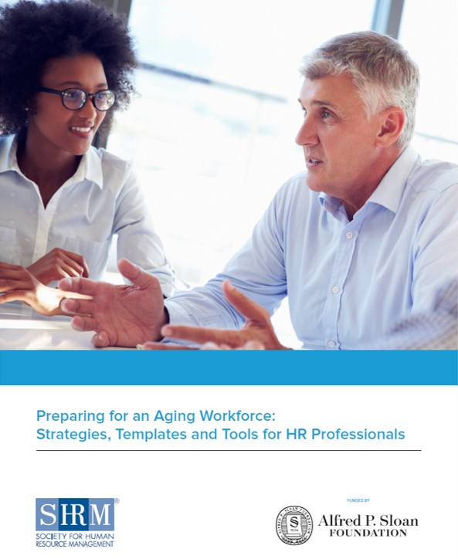
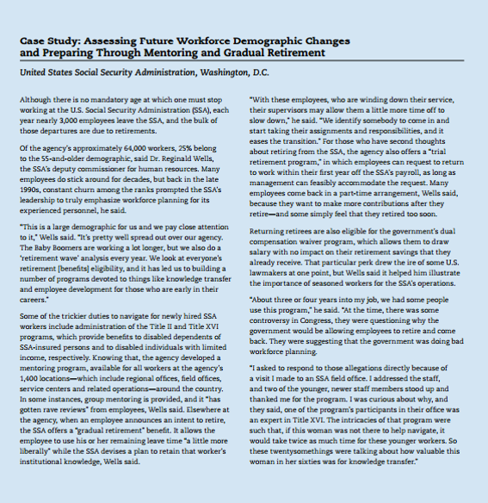
Templates & Tools
Notes:
To help you with these action steps, SHRM and the SHRM Foundation have created a number of easy-to-use, free resources. They will help you analyze the current state of your workforce and then maximize the value of mature workers to your organization.
Your starting point should be this comprehensive guidebook on “Preparing for an Aging Workforce”. It takes you step-by-step through building the business case for older workers, assessing the current state of your workforce, and then developing practical strategies to recruit, retain and engage an age-diverse workforce. It includes worksheets, checklists, quizzes and real-world case studies to guide you along the way.

Slide 23
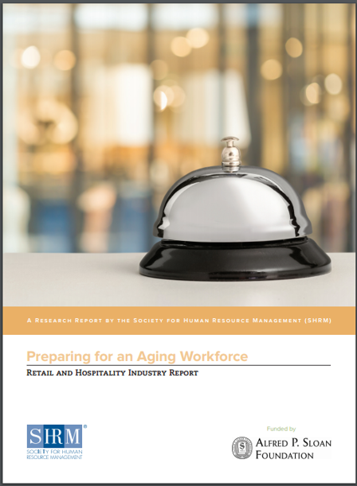
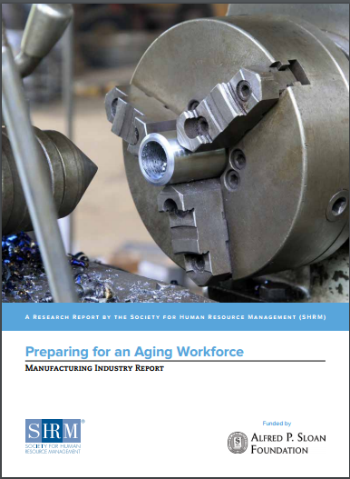
Industry Reports
http://www.shrm.org/agingworkforce
Notes:
If you want to get customized advice for your particular industry, take a look at this series of special reports. They target seven different industries that have been impacted by an aging workforce: health care, manufacturing, oil, gas and mining, retail, government, finance and professional services. So for customized information that applies specifically to your type of business, please go online and download one of these reports.

Slide 24
SHRM Foundation Resources
Strategies and best practices from leading companies
Practical guidance for all size organizations
Executive briefings to share with managers
Notes:
When you go to the website, you’ll find additional resources as well including: The SHRM Foundation’s Effective Practice Guidelines report on The Aging Workforce. It provides specific strategies and case studies from a range of companies such as CVS, Mercy Health System, Fidelity and the National Institutes of Health (NIH). It explains how you can implement similar, successful strategies in your own workplace.
In addition the SHRM Foundation has created a variety of short 3-5 page briefings that you can share with your line managers or leaders to help educate them on these issues.

Slide 25
How Can State Director Assist?
Refer to other Chapters for best practices
Provide contacts of organizations that provide workforce readiness services
Help with workforce readiness events in your chapter
Serve as a liaison to SHRM

Slide 26
SHRM (National) Webinars
May 17, 2017 – webinar
August 16, 2017 – webinar
November 14, 2017 – webinar
All at 4pm!
Refer to the Volunteer Leader Webcast Series on the VLRC for archived webcast/webinars for Core Leadership Areas

Slide 27
State Conference Calls
Looking for feedback on the frequency (i.e. monthly, quarterly, bi-monthly, every 6 months)
Good for idea sharing and current chapter initiatives (Thinking of JA in May?)
Follow up to SHRM calls/webinars
Statewide Initiative
Statewide Committee/team

Slide 28
Thank you!
Fannie Glover fglover@earlycareandlearning.org 518-690-4217 ext. 18
Visit shrmfoundation.org/AgingInitiative to download your complimentary resources.
Notes:
In conclusion, I hope you have a better understanding now of the challenges and opportunities of the aging workforce and what you can do to prepare. Please visit the website to download these complimentary resources created by SHRM, the SHRM Foundation and funded by Sloan and then take action in your own organization.
Thank you!

